Slide 1
- Peakflow +
↑ SY (Specific Yield)
↓ CN2
↓ SOL_AWC().sol
↓ Riverbed Conductance
↑ CH_W2.rte
↑ CH_K2.rte
↑ CH_D2.rte
↑ ESCO.hru
↓ HRU_SLP.hru (longer recession)
↑ HRU_SLP.hru (shorter recession)
- Baseflow +
↑ SOL_AWC().sol
↓ HK (Horizontal Hydraulic Conductivity
↓ CN2
Lower Watertable
↓ SY (Specific Yield)

Slide 2
Left to Shift to right
↑ CH_N2.rte
↓ HRU_SLP.hru (longer recession)
↓ CH_N2.rte

Slide 3
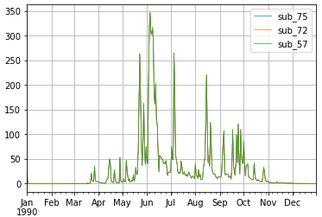
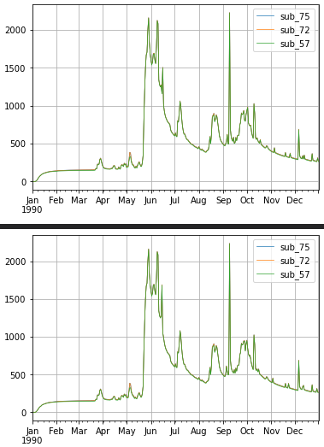
Simulation Period: 1/1/1990 – 12/31/1990
Time Step: Daily
a) APEX
b) APEX-MODFLOW

Slide 4
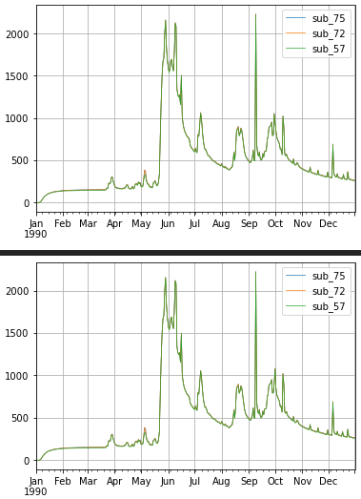
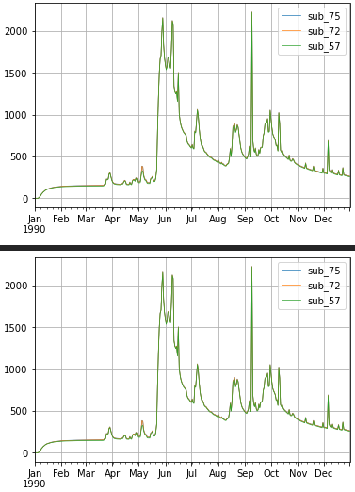
Channel bottom width/depth in m/m; Channel flow rate (QG) > 0. (Range: 1-20) (5.0)
Floodplain width/channel width in m/m (Range: 2-50)
(10.00)
Floodplain saturated hydraulic conductivity adjustment factor (Range: 0.1-10) Fraction multiplied by the 2nd soil layer saturated conductivity. (2)

Slide 5
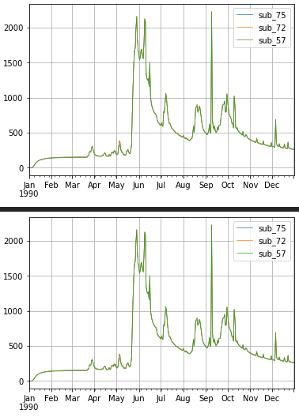
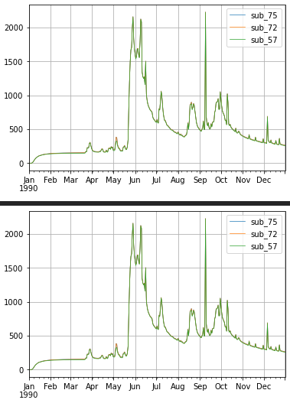
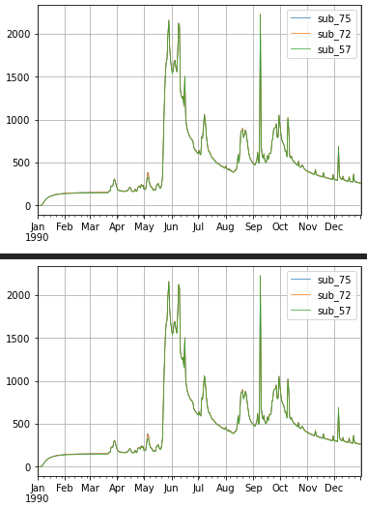
Maximum ground water storage in mm (Range: 5-200)
(100)
Return Flow / (Return Flow + Deep Percolation) (Range: 0-1) Setting this value closer to 1.0 means more flow will be partitioned to return flow. (0.8)
Saturated Conductivity adjustment factor
(use with Green & Ampt). (Range: 0.01-10) Fraction multiplied by the 2nd soil layer saturated conductivity to estimate Green & Ampt saturated conductivity (SATK)
(1)

